Slide 1
Section 7.1 Scaled Diagrams
© Copyright all rights reserved to Homework depot: www.BCMath.ca

Slide 2
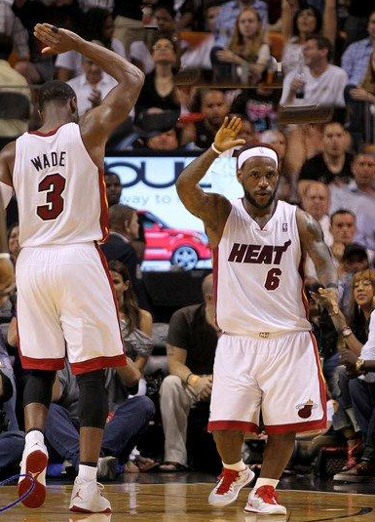
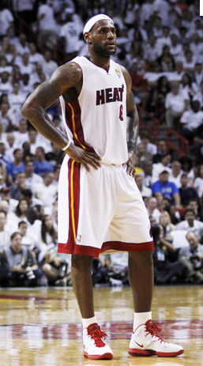
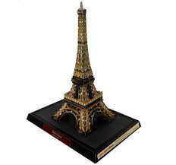
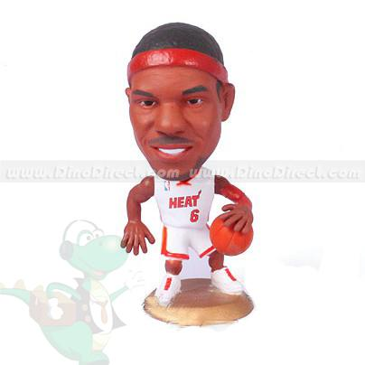

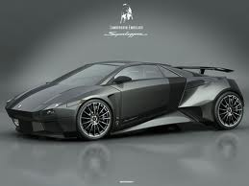
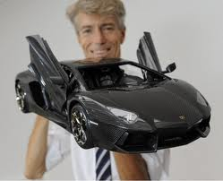
What are Scaled Diagrams?
A scaled diagram or scaled object is an enlargement or reduction of another object
Scaled diagrams/objects are found in toys, construction, and pictures
Scaled objects must have the same proportions as the actual object
This action figure isn’t a scaled diagram because the head is not proportional to the body!!
© Copyright all rights reserved to Homework depot: www.BCMath.ca

Slide 3
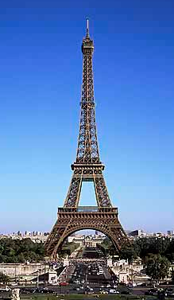
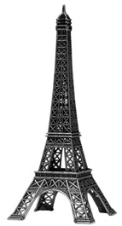
Properties of Scaled Diagrams
All corresponding parts must have the same proportions
The proportion is based on the “scaled factor” – a number that tells you how many times bigger or smaller is the scaled object compared to the actual object
© Copyright all rights reserved to Homework depot: www.BCMath.ca

Slide 4
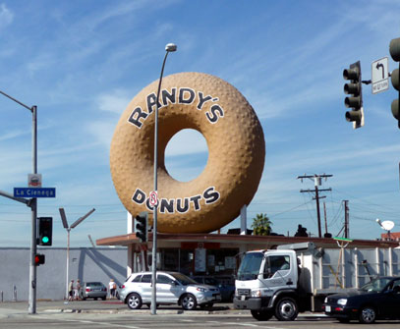
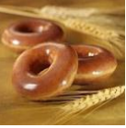
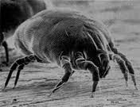
Ex# Indicate the scaled factor for each of the following:
The body of a house dust mite is just visible against a dark back- ground in normal light. A typical house dust mite measures 0.4 millimetres
© Copyright all rights reserved to Homework depot: www.BCMath.ca

Slide 5
Ex: The following object is to be increased by a scaled factor of 3.5. Draw the scaled diagram with the grid provided
© Copyright all rights reserved to Homework depot: www.BCMath.ca

Slide 6
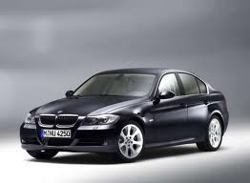
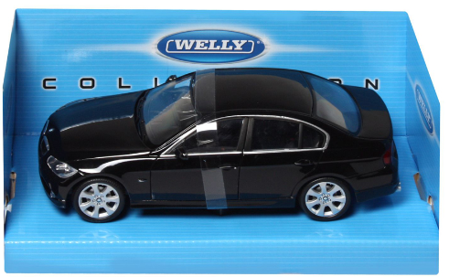
Ex: The following is a picture of a BMW with a scaled factor of 1/20. What is the actual length of the car?
© Copyright all rights reserved to Homework depot: www.BCMath.ca

Slide 7
Homework:
P323 #4-7, 11, 12, 15
© Copyright all rights reserved to Homework depot: www.BCMath.ca

